Slide 1
Employee Performance Analysis Using Excel
PRESENTED BY: Divyadharshini.S
REGISTER NO: 312204568
DEPARTMENT: Commerce
COLLEGE: K.C.S Kasi Nadar college of arts and Science

Slide 2
PROJECT TITLE
Employee Performance Analysis Using Excel

Slide 3
AGENDA
1.Problem Statement
2. Project Overview
3.End Users
4.Our Solution and Proposition
5. Dataset Description
6. Modelling Approach
7. Results and Discussion
8.Conclusion

Slide 4
PROBLEM STATEMENT
The performance distribution among different employees (Alana, Alisa, Clayton, etc.) shows a significant imbalance, particularly in the "Exceeds" category.
While most employees have similar performance levels across the "Fully Meets" and "Needs Improvement" categories, one employee, Saniya, dramatically outperforms others in the "Exceeds" category, as reflected in the exponential trend line.
This anomaly raises questions about the factors contributing to Saniya's exceptional performance and whether similar strategies can be applied to other employees to achieve more balanced performance results.
The challenge is to identify the underlying causes of this disparity and develop a strategy to elevate

Slide 5
PROJECT OVERVIEW
Identify and analyze the performance disparity among employees.
2. Investigate the factors behind the outlier's exceptional performance.
3. Develop strategies to replicate high performance across the team.
4. Implement interventions to achieve balanced and improved overall results.
5. Monitor and evaluate the impact of these strategies on team performance.

Slide 6
WHO ARE THE END USERS?
Human Resources (HR) Team* - To implement strategies for improving employee performance.
2. Team Managers* - To guide and support their teams in achieving balanced performance.
3. Employees* - To benefit from personalized development plans and performance improvement strategies.
4. Senior Management* - To make informed decisions based on performance analysis and trends.
5. Learning and Development (L&D) Team* - To design training programs targeting identified performance gaps.

Slide 7
OUR SOLUTION AND ITS VALUE PROPOSITION
Filtering - Remove missing values.
Conditional Formatting - Blanks, Background Color Shading, Data Bars, Values.
Data Filtering and Sorting - Identify specific employee groups, such as those with low or high performance ratings
Pivot table - Summary of employee performance under their current rating.
Graphs - FINAL REPORT.

Slide 8
DATASET DESCRIPTION
EMPLOYEE ID: Unique identifier for each employee in the organization.
FIRST NAME: The first name of the employee.
PAY ZONE: The pay zone or salary band to which the employee's compensation falls.
DEPARTMENT TYPE: The broader category or type of department the employee's work is associated with.
CURRENT EMPLOYEE RATING: The current rating or evaluation of the employee's overall performance.

Slide 9
MODELLING
Data set: Kaggle, Employee dataset
Feature Selection:
Data Cleaning: Missing values, Irrelevant
Pivot Table: Employee ID, First Name, Payzone, DepartmentType, Current Employee Rating.
Performance:
Report: Slicer

Slide 10
RESULTS

Slide 11
CONCLUSION
Addressing performance disparities within the team is crucial for maximizing productivity and ensuring consistent, high-quality outcomes. By understanding the factors behind exceptional performance and applying these insights across the board, we can create a more balanced and motivated workforce. Our solution not only aims to elevate overall team performance but also strengthens the foundation for sustainable growth and long-term success for the organization.

Slide 12
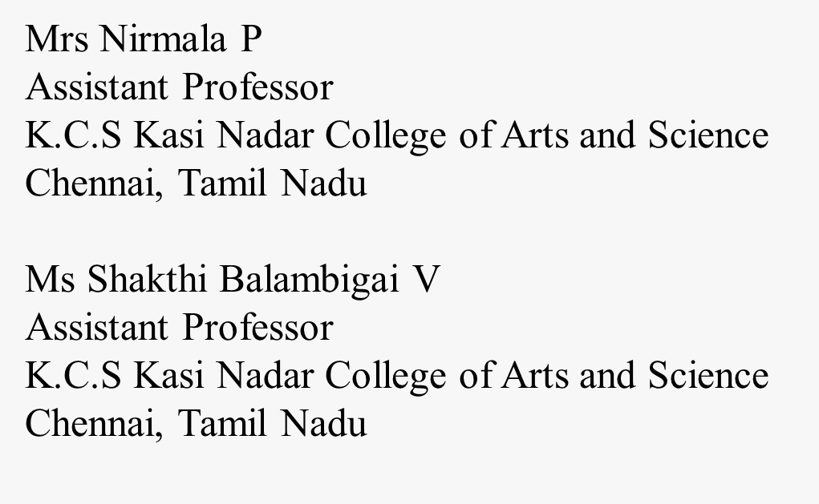
REFERENCE

